Slide 1



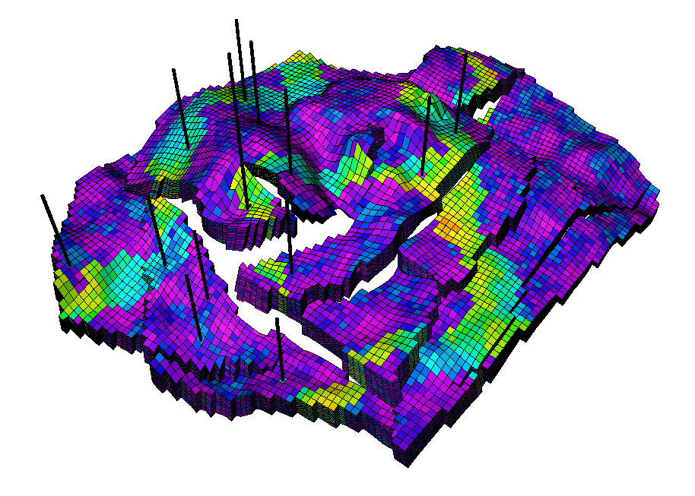

1
Subsurface Energy Data Science
Well Drawdown Control for Production Optimization in
Unconventional Reservoirs
Mahammad Valiyev
Viterbi School of Engineering
University of Southern California
Annual Symposium and Advisory Board Meeting
Los Angeles, California | April 24, 2024
Industrial Research Chair

Slide 2
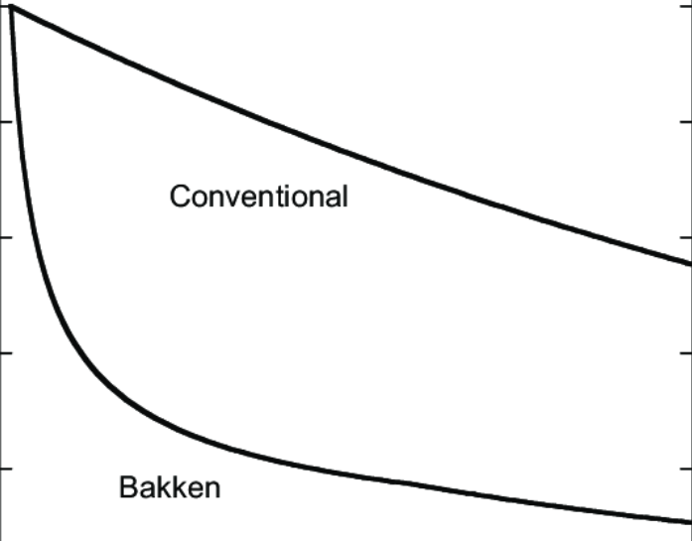
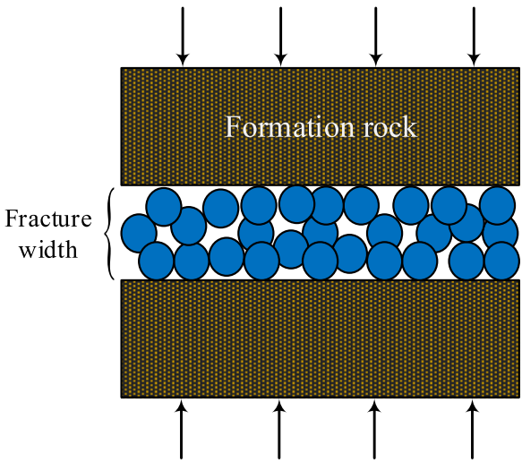
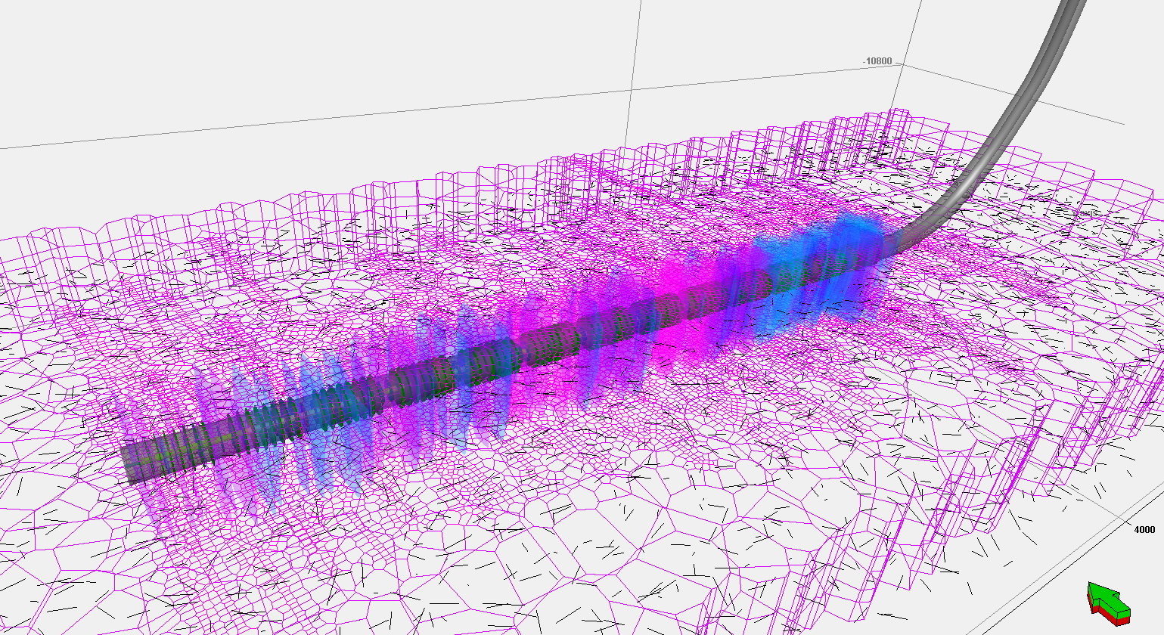
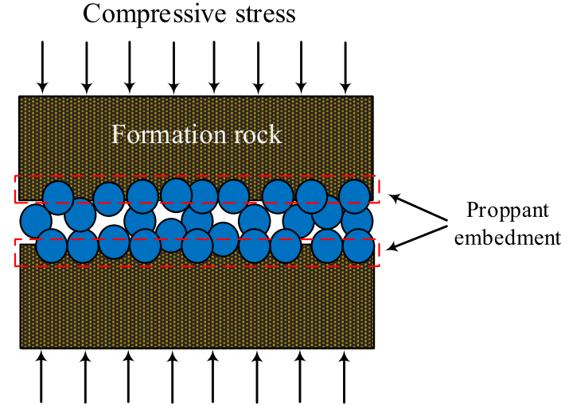
Motivation
Rapid production decline in unconventionals
Cross-sectional view of fracture aperture
Conventional
Before
compaction
Oil production
Unconventional
Time
Compressive stress
After
compaction

Slide 3
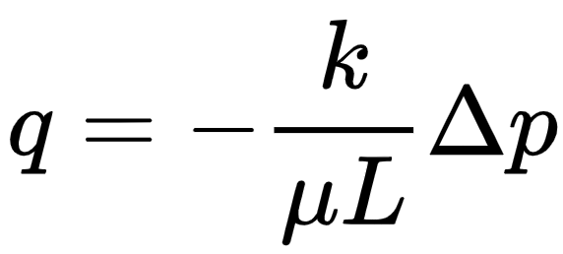
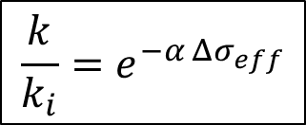
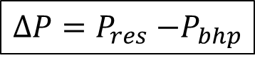
Motivation
Permeability
Drawdown
$$\frac{k}{k_{i}}=e^{−α Δσ_{eff}}$$
$$∆P=P_{res}{−P}_{bhp}$$
competing effects
Permeability
conservation
Drawdown
rate
Determining the optimal point is not straightforward

Slide 4
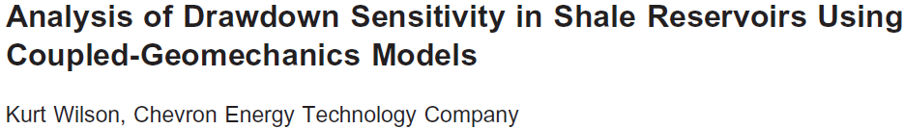
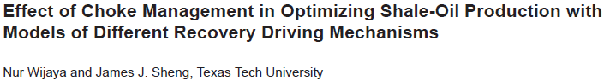
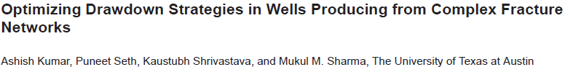
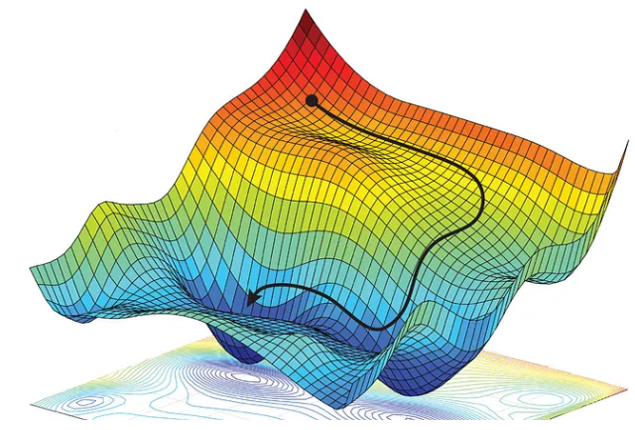
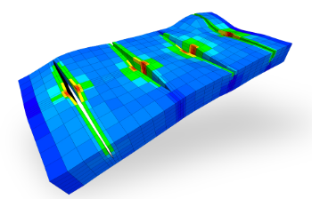

Literature review and our contribution
Gaps in the literature:
Fluid flow-only models
Single-fracture models
Ad-hoc methodology for optimal drawdown selection
Our contribution
Optimization for selection of control
Field-scale fully coupled flow geomechanics model
Unique insights based on a realistic methodology

Slide 5

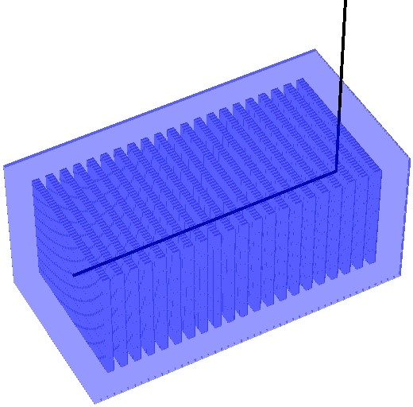
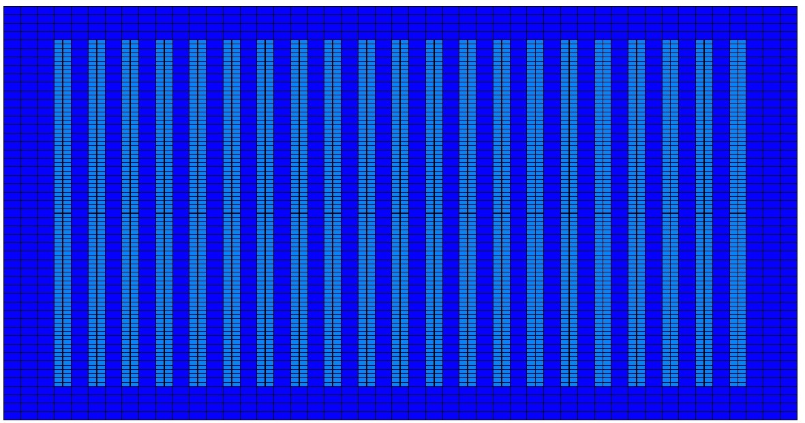
Methods: modeling approach
Propped fracture
zone
Unpropped fracture zone
Matrix
3D, field-scale, fully coupled flow geomechanics model
Multi-stage hydraulically fractured well
3 zones: propped fractures, unpropped fractures, matrix

Slide 6
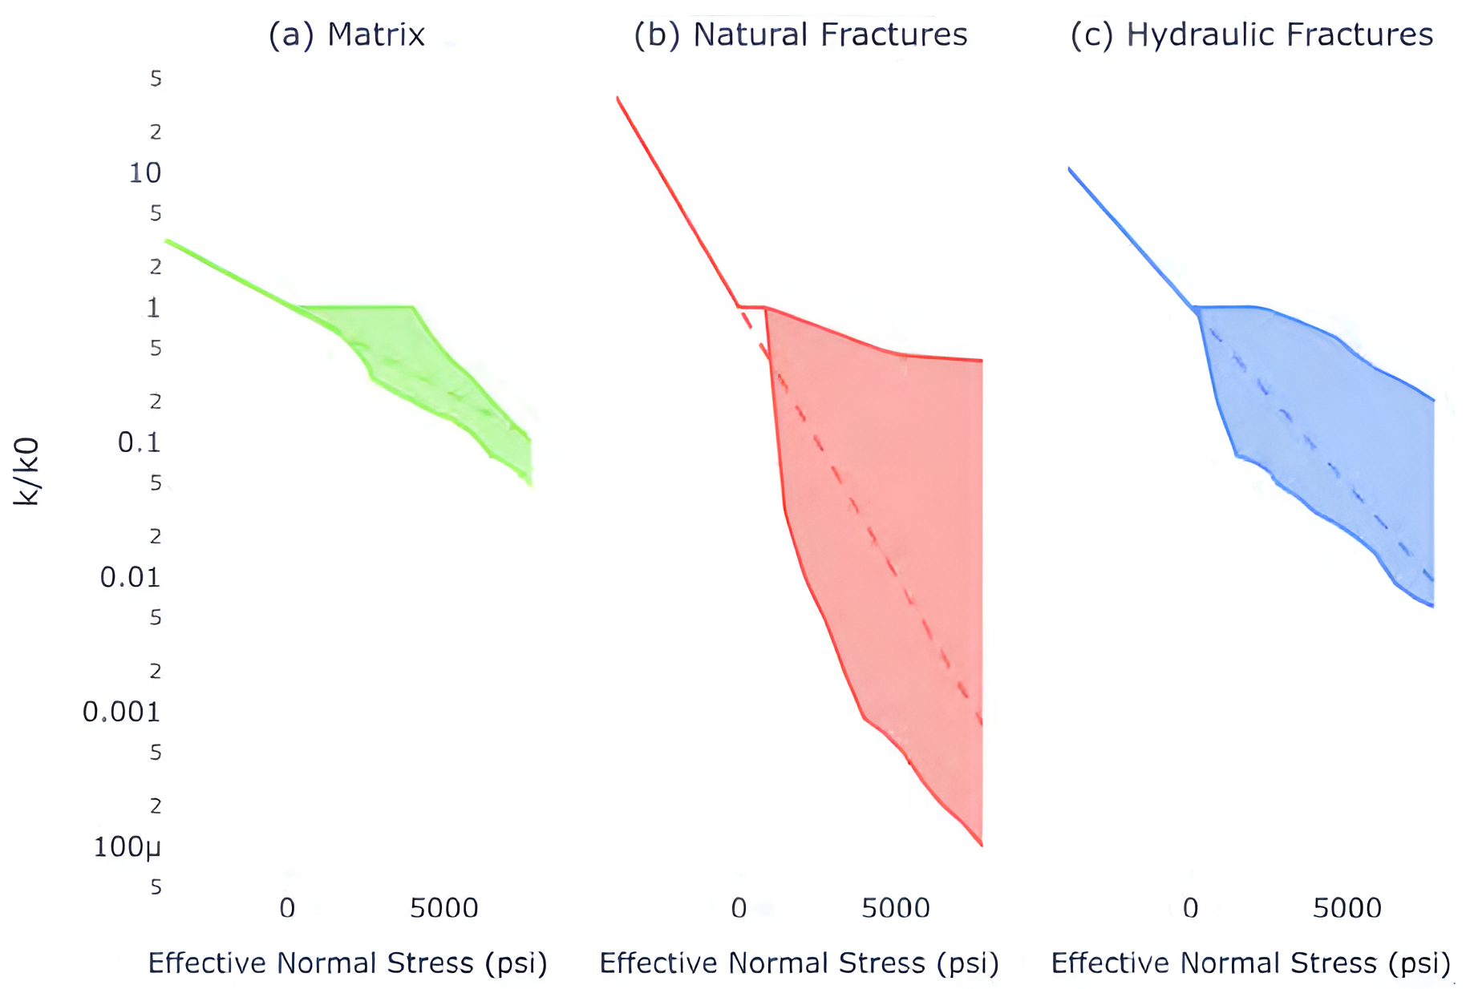
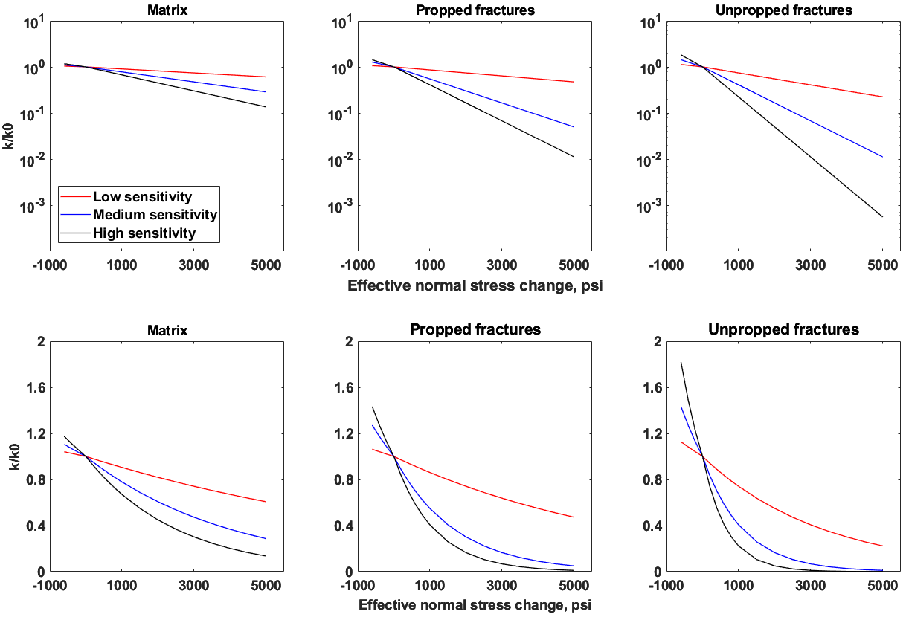
Methods: uncertainty analysis
Stress-dependency of different reservoir media:
SPE-201490-MS
Stress-dependency of different reservoir media:
our study

Slide 7
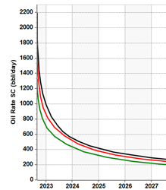
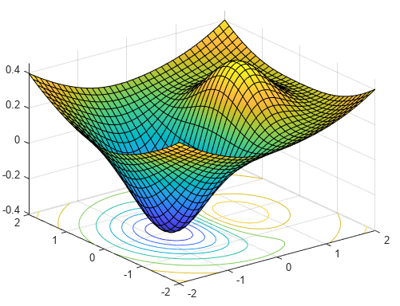
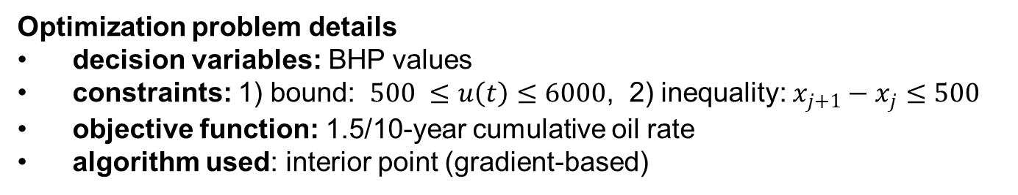
Methods: optimization setup
Input: BHP
BHP 1
BHP 2
.
.
.
BHP n
Simulator
Output:
1.5 / 10-year cumulative oil rate
Optimization algorithm
Input:
n control values
Optimization problem details
decision variables: BHP values
constraints: 1) bound: $500 ≤u\left(t\right)≤6000$, 2) inequality: $x_{j+1}−x_{j}≤500$
objective function: 1.5/10-year cumulative oil rate
algorithm used: interior point (gradient-based)

Slide 8
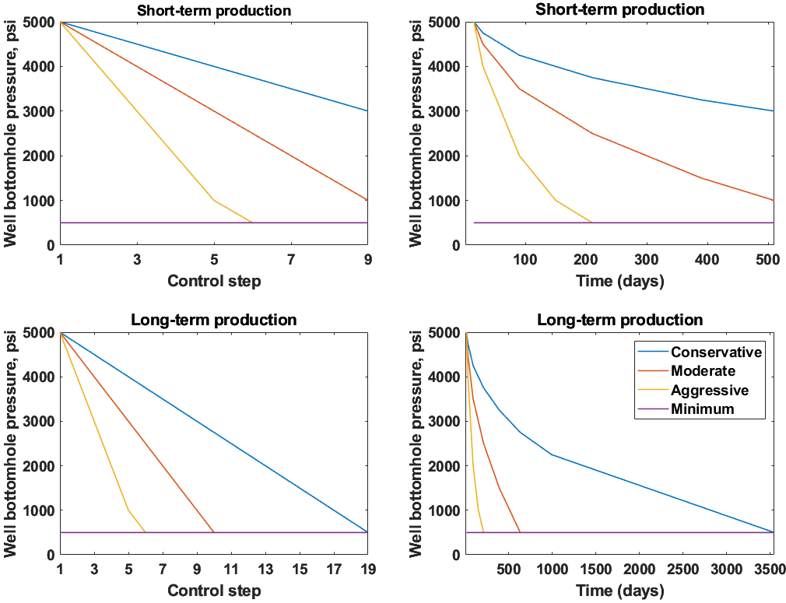
Results: drawdown scenarios design
Pre-defined BHP profiles for short and long-term production periods

Slide 9
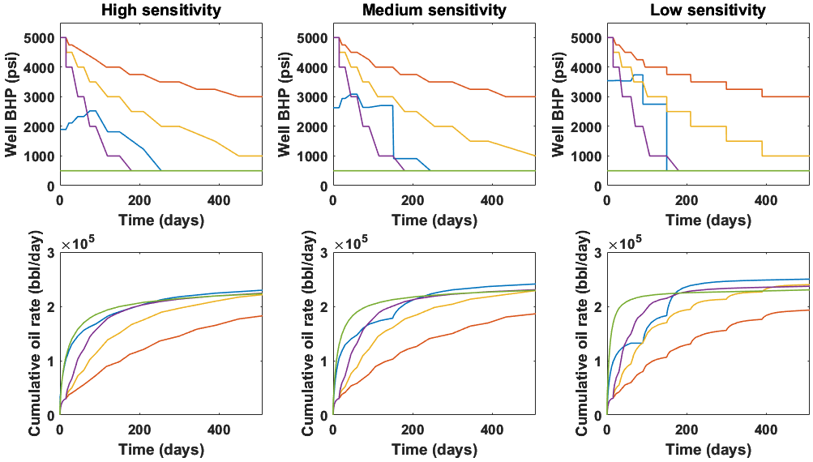
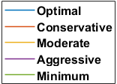
Results: short-term production period
Well BHP and cumulative oil curves for a short-term production period

Slide 10
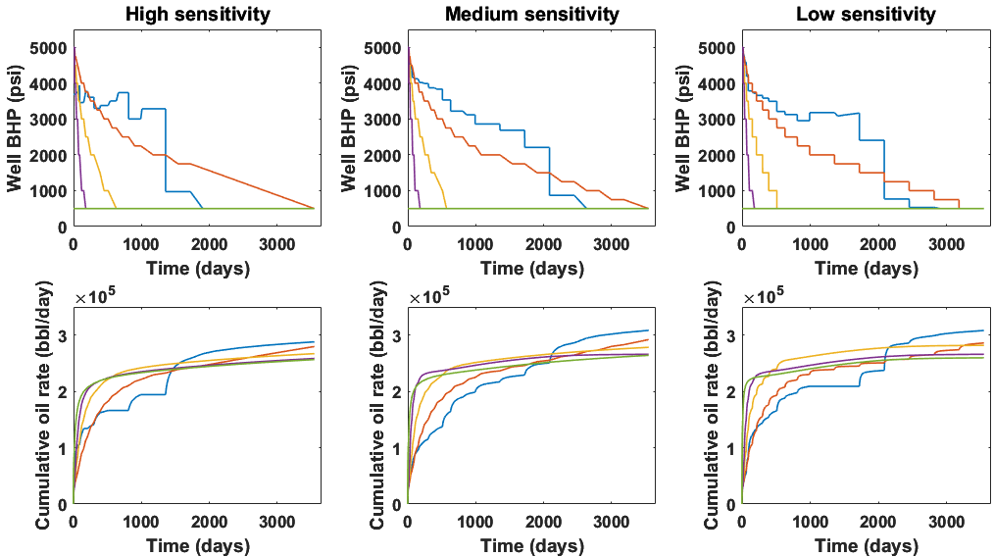
Results: long-term production period
Well BHP and cumulative oil curves for a long-term production period

Slide 11
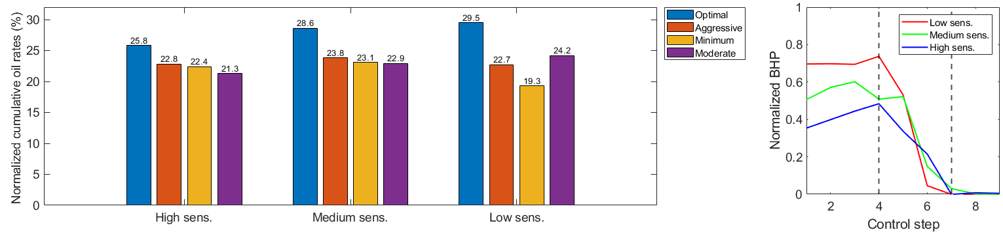
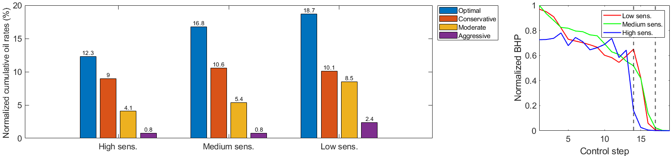
Results: summary bar charts and optimal BHPs curves
Short-term
Long-term

Slide 12
Conclusion
New control drawdown approach non-trivial improvement over standard methodology
As stress sensitivity of media , production period , amount of improvement
Optimal drawdown trajectories are generally similar for short and long-term production with some peculiarities
An attempt was made to link general and specific trends in optimal curves to physics
Future work: inclusion of 1) natural fractures 2) heterogeneity and uncertainty in reservoir description 3) use of data-driven proxies

Slide 13
13
Subsurface Energy Data Science
Thank you!
Industrial Research Chair

